Slide 1
RISC-V Controlled
INT8 CNN Accelerator
on FPGA
Tang Nano 20K • RV32I • INT8 CNN • microSD • UART • HDMI
Group 7 | Ho Chi Minh City University of Technology and Engineering | October 2026

Slide 2
From a Fixed Demo to a Reloadable Edge AI System
The solution separates fixed hardware, reloadable firmware and replaceable AI data.
FIXED HARDWARE
bitstream in external Flash
RELOADABLE ASSETS
firmware over UART + data on microSD
stable accelerator fabric
Rebuild only when the FPGA hardware changes.
Programs, weights and inputs can change without place-and-route.

Slide 3
System Architecture

Slide 4
Boot, Inference and Reload Sequence
A fixed FPGA image supports a repeatable boot, inference and firmware-reload path.
1 Restore hardware from Flash
2 Load IMEM + DMEM over UART
3 Validate RCN1 + load sample
4 Conv1 / Conv2 in RTL
5 Complete layers + HDMI result
6 Hold reload input ~0.5 s
Control-plane reload ≠ FPGA reconfiguration

Slide 5
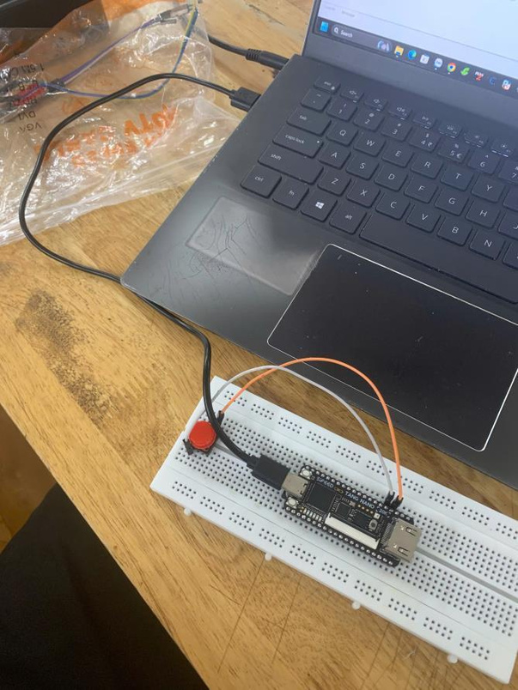
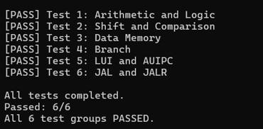
RV32I Core and UART-Loaded Instruction Memory
Standalone validation build
1 KiB instruction memory
133 instructions, 532 bytes
UART at 115,200 baud
6 / 6 instruction groups passed
Integrated AI SoC uses separate 8 KiB IMEM and 8 KiB DMEM.

Slide 6
LeNet-Inspired INT8 Inference Pipeline
Signed INT8 activations and weights, INT16 products and INT32 accumulators.
INPUT
1 × 28 × 28
CONV1 + RELU
16 × 28 × 28
POOL1
16 × 14 × 14
CONV2 + RELU
32 × 14 × 14
POOL2
32 × 7 × 7
FC1 128
FC2 10
Conv1 and Conv2 run in RTL. Pooling, requantization, FC1, FC2 and Argmax run in RV32I firmware. The accelerated convolutions represent 83.4% of learned-layer MACs, not a measured speedup.

Slide 7
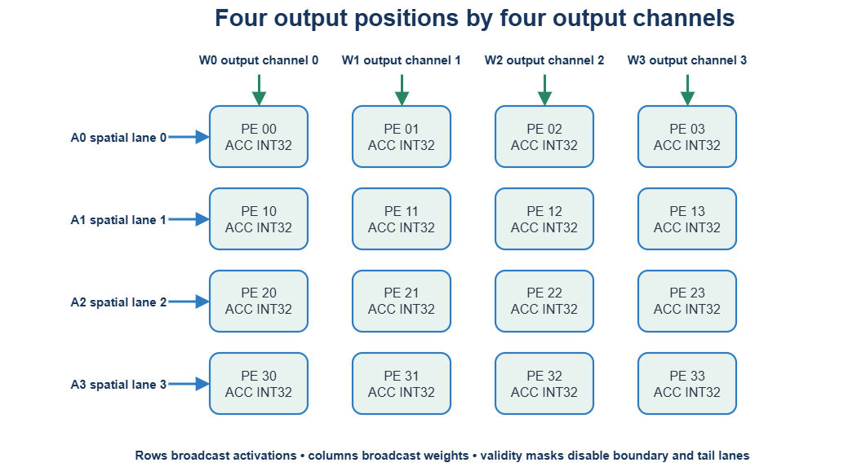
4 × 4 Convolution Accelerator
Sixteen PEs map four output positions by four output channels with boundary masks.
Peak: 16 signed INT8 MACs/cycle
4 activation lanes (row broadcast)
4 weight lanes (column broadcast)
Local buffers
3,136 INT8 inputs
4,608 INT8 weights
12,544 INT32 outputs
States: IDLE • CHECK • RUN • DONE • ERROR

Slide 8
microSD Data and Firmware Workflow
HOST PREPROCESS
PNG • JPG • JPEG • BMP
RCN1 V3 RAW IMAGE
model + 100 records
SECTOR WRITE
+ read-back
CRC32 VERIFY
image + record
VALID COMMIT
then AI Runtime
290,816 bytes • 568 sectors • 100 fixed sample slots • incomplete updates never become valid

Slide 9
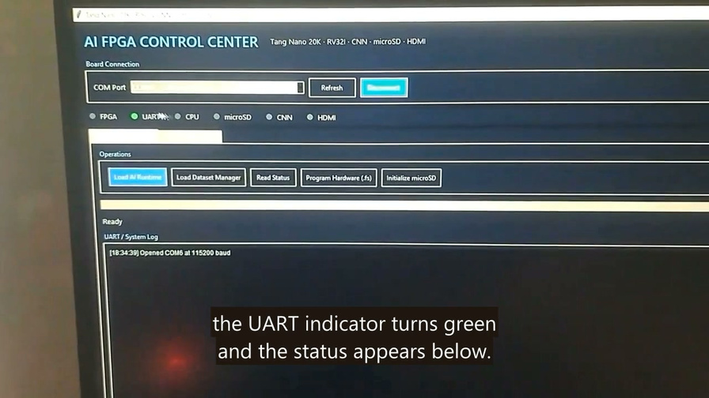
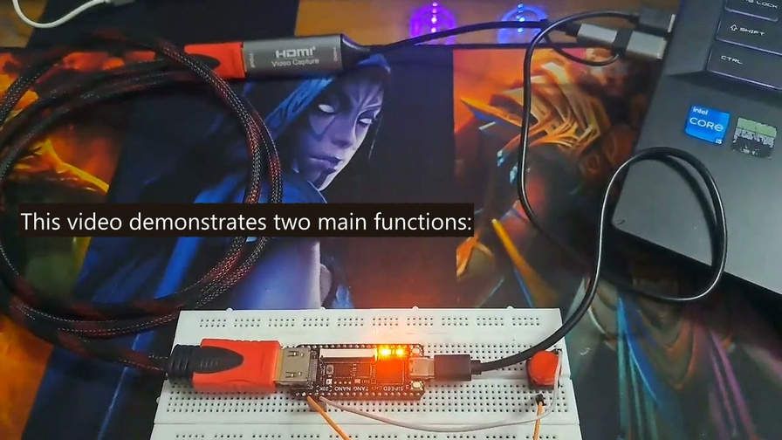
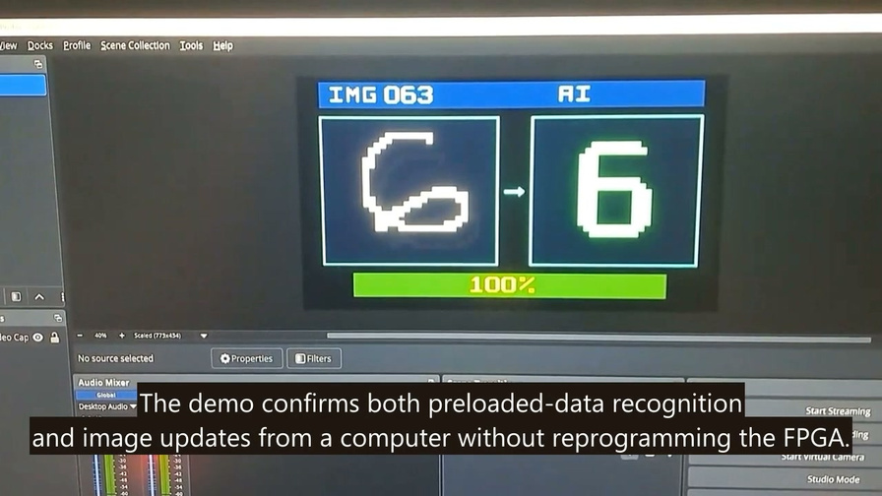
Integrated Board Demonstration
A repeatable host-to-board workflow with real UART, microSD and HDMI evidence.
CONTROL CENTER
connect • program • load
TANG NANO 20K
USB-UART • microSD • HDMI
HDMI RESULT
image • class • confidence

Slide 10
Verification Strategy
Verification progresses from arithmetic and tensor references to full firmware and board behavior.
MODEL: Float32 and integer references • golden tensors
RTL: MAC • PE array • buffers • address generation • MMIO
SYSTEM: UART-loaded firmware • SDHC model • full CNN regression
BOARD: all 6 RV32I groups passed • UART logs • HDMI evidence

Slide 11
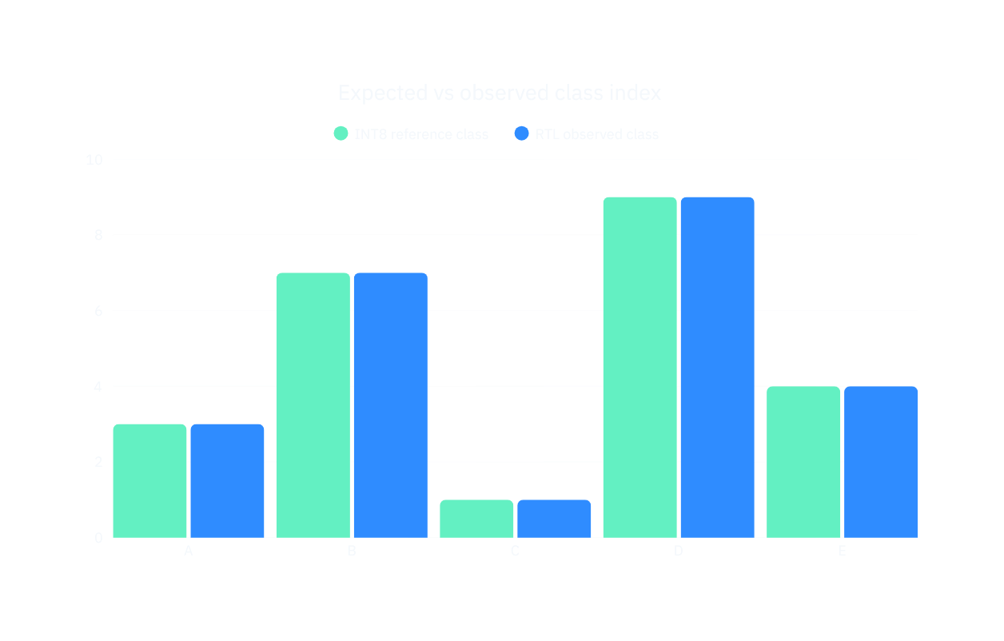
Verified Model Results
Only recorded model and integer-reference results are presented as quantitative evidence.
NOT YET RECORDED
Physical-board accuracy across all 100 samples
End-to-end latency
Software-only RV32I baseline
Measured accelerator speedup
These results are intentionally not claimed.

Slide 12
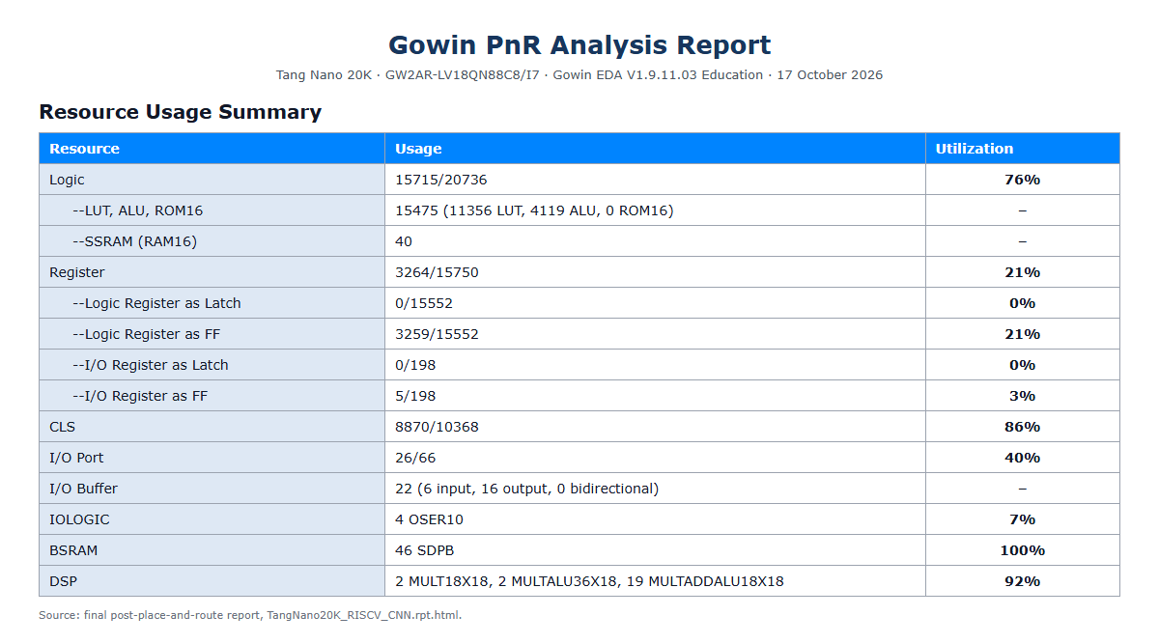
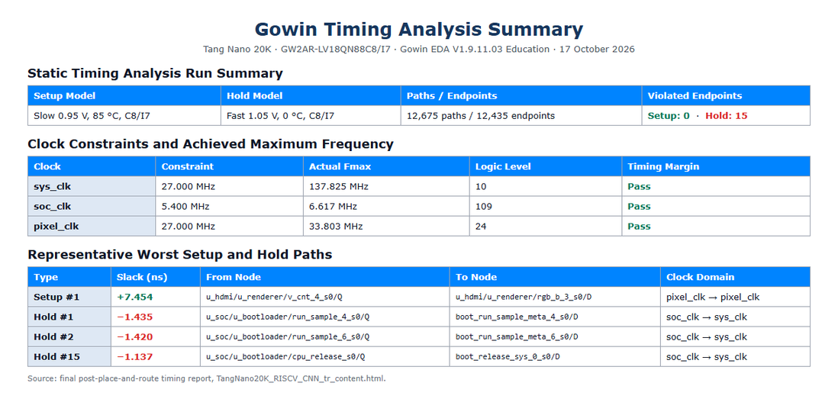
FPGA Implementation and Timing
Final Gowin post-place-and-route evidence for the Tang Nano 20K target.
Logic 15,715 / 20,736 • 76%
Registers 3,264 / 15,750 • 21%
BSRAM 46 / 46 • 100%
DSP 22 / 24 • 92%
Setup passes
SoC target 5.4 MHz
Reported Fmax 6.617 MHz
15 hold-violated endpoints remain.
Complete timing closure is not claimed.

Slide 13
What the Project Delivers
RELOADABLE
RV32I FIRMWARE
INT8 CNN
ACCELERATOR
microSD
ASSET PIPELINE
UART + HDMI
OBSERVABILITY
The project combines RTL, C firmware, Python host tools, INT8 model artifacts, verification environments and physical-board evidence. Next priorities: hold closure, cycle counters, a version-matched 100-sample board log and a software-only RV32I baseline.

Slide 14

Project Repository
Source code, technical documentation, implementation evidence and project demonstrations.
GITHUB REPOSITORY
https://github.com/NguyenKT0911/Embedded-system-final
YOUTUBE PLAYLIST
https://www.youtube.com/playlist?list=PLU8j17gnRm0I
Group 7 • Ho Chi Minh City University of Technology and Engineering • October 2026
Scan to open the repository

